Slide 1
MIABIS model for data describing sample and sample donor
MIABIS Sample and Donor WG

Slide 2
A short history of MIABIS
Stands for Minimum Information About Biobank data Sharing
The MIABIS standard was created in 2012 by BBMRI.se
Norlin et al., Biopreserv Biobank. 2012
Motivation: to simplify the exchange of data between biobanks and research projects
MIABIS Core contains attributes to describe biobanks, sample collections and studies
Aggregated level of information and metadata
Updated in 2016 (current version 2)
Used by BBMRI-ERIC Biobank Directory and by other networks
MIABIS is currently being extended to different use cases:
Individual level data about samples and sample donors
Laboratory SOPs
Link: https://github.com/MIABIS/miabis/wiki

Slide 3
Scope of the MIABIS components Sample and Donor
Aimed for sharing information on samples and sample donors at individual level
Use cases for data sharing:
BBMRI-ERIC Sample Locator service – to allow researchers to identify samples suitable for study
Transferring sample information between different software solutions - UKCRC Tissue Bank
Infrastructure projects linking samples & data from different sources (biobanks, registries, databases) – RD-Connect
Sample-level catalogs to promote accessibility and findability of samples

Slide 4



BBMRI-ERIC
Biobank
Sample locator
Connector
Q
?
Search interface
Q
Negotiator
Biobank
Connector
Q
Next steps (e.g. ethics approval)
Biobank
(!) The Sample locator will be based on MIABIS sample and donor attributes
Connector
Slide from Rumyana Proynova, DKFZ

Slide 5
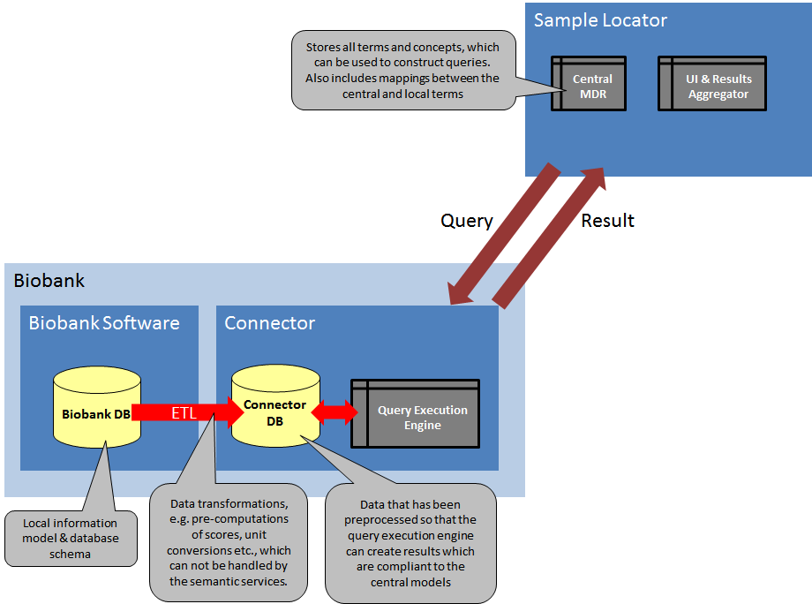
CS-IT Architecture plan

Slide 6
Guiding principles in the terminology work - Scope
Only samples of human origin
Capture information on the current status of samples stored in a given biobank
sample handling and processing history are not included
Applicable to all types of samples and all sample donors
no sample type specific data items

Slide 7
Guiding principles in the terminology work - implementation
The information provided for samples and sample donors should be searchable on its own, with no dependencies on other sources of information
the only dependency should be between sample and sample donor
No hierarchy structure between the different data items is defined, except for simple link items
each use case and each infrastructure can define the data structure as needed for its own purpose
Use already existing standards and best practices as much as possible
no need to reinvent the wheel

Slide 8
Person component: donor as a role
Person component, a superclass for different roles
Sample donor is one of the roles a person may have
Others roles anticipated to be added are Patient and Study participant
Describing new roles is out of the context of current work
Person attributes: Person ID, sex, birth date&time,vital status, vital status date&time
→Person attributes are common to all person roles
Sample donor specific attributes: Sample donor ID, data categories, birth year
Person
Patient
Sample Donor
Study participant

Slide 9
Sample component
Extended the attributes describing samples in the ‘Sample collection’ –component
Added attributes related to sample and its storage from SPREC: Detailed material type, Preservation parameters and Sample storage container
Included also Sample quantity, Sample quantity unit, Sample creation date, link to processing protocol and sample content diagnosis information
Use restriction refers to the restrictions that may change the availability of the samples donated by the sample donor
Sample
Attribute
Sample ID
Detailed material type
Preservation parameters
Sample storage temperature
Sample storage container
Sample creation date and time
Anatomical site
Sample quantity
Sample quantity unit
Processing protocol
Sample content diagnosis
Use restrictions

Slide 10
Possibilities to register events
Simple structure to describe events at different time points: event name, event ID, age at event, event date and time
In the current MIABIS proposal the following events were defined:
Sampling event
Disease diagnosis event
Death event
(Data collection event - expected to be added at a later stage)
Sampling event
Event ID
Age at event
Event date and time

Slide 11
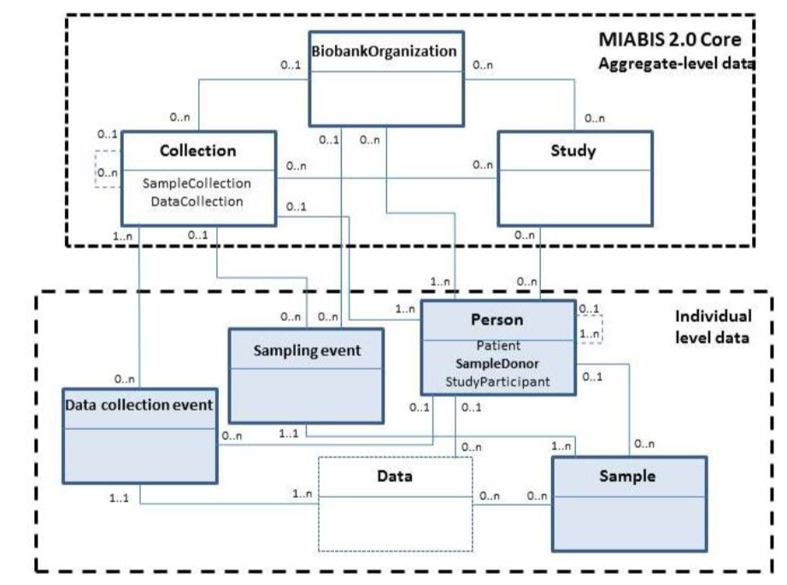
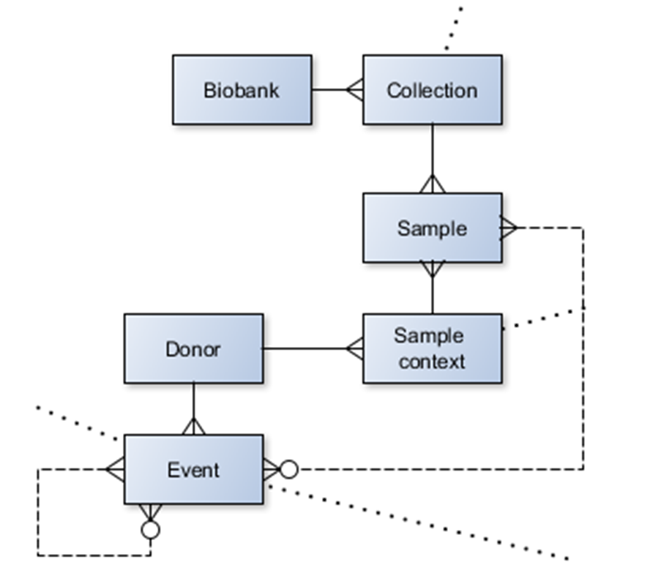
Sample and donor data model
MIABIS data model in sample and donor proposal - (NB. data model is under revision!)
Example of database implementation
Notes:
Note: in the example of database implementation a sample context is present. That is used to define the sample role (diagnostical, research etc)
Task for the hackathon: What would be a good data model for the sample and donor proposal that would be unambiguous enough to be used in different database implementations.

Slide 12
The ID mapping schema between the different components
Person
PersonID
Sex
…
Event
EventID
EventDate
…
ID_mapping_table
PersonID
SampleDonorID
SampleID
EventID
Sample donor
SampleDonorID
Data categories
…
Sample
Sample ID
Detailed material type
…

Slide 13
Implementation challenge
The current data model is too complex and difficult to implement – how can we make it more modular and simple?
we are happy to obtain suggestions from you…

Slide 14
How BioSchemas & MIABIS are linked
Similar aims:
The findability of samples for specific research questions
Defining a minimal set of common (& informative) data elements
Common use cases: BBMRI Biobank Directory, the UKCRC Tissue Directory
Focus on interoperability & sharing of data

